Slide 1
SDN in Docker
By
Vivek Nagalapura Ravindra
Amith Kumar Matapady

Slide 2
Contents
Introduction
Installation
Architecture
Docker Networking Using OpenvSwitch
Wireshark in Docker
Opendaylight in Docker
Challenges faced
Conclusion

Slide 3
Introduction
Docker - Set of platform as a service (PaaS) products that uses OS-level virtualization to deliver software in packages called containers.
OpenvSwitch - open-source implementation of a distributed virtual multilayer switch.
GRE - communication protocol used to establish a direct, point-to-point connection between network nodes.
Virtual Ethernet Device - The virtual Ethernet devices (or veth devices) is a local ethernet tunnel. They can act as tunnels between network namespaces to create a bridge to a physical network device in another namespace, but can also be used as standalone network devices.
Linux Bridge - Linux bridge is a layer 2 virtual device that on its own cannot receive or transmit anything unless you bind one or more real devices to it.

Slide 4

Installations
Ubuntu VMs
Docker
OpenvSwitch
Wireshark
Java Development Kit (JDK 11)
OpenDaylight

Slide 5
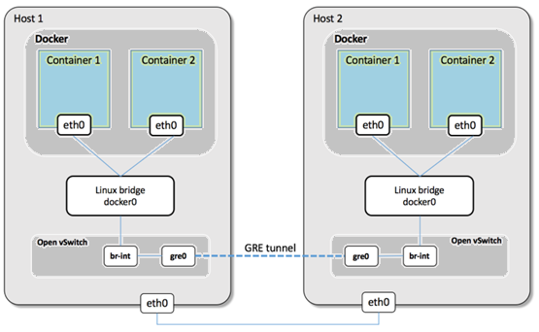
Architecture
We first spin-up two containers on the Dockers
Then connect the docker to the linux bridge
We connect the linux bridge to one end of a virtual ethernet device
Then we establish a connection from the other end of the virtual ethernet device to a port for gre tunnelling using Open vSwitch

Slide 6
Implementing docker using OVS bridge
Docker container – CentOS on both hosts which acquires IP Addresses
Set up the OVS bridge on both the containers
Ping each other
Connect the docker to linux bridge

Slide 7
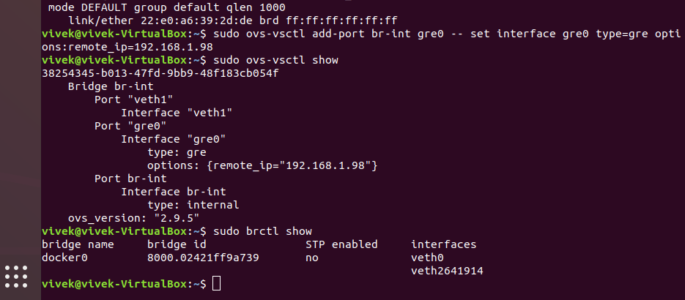
OVS and linux bridge connections

Slide 8
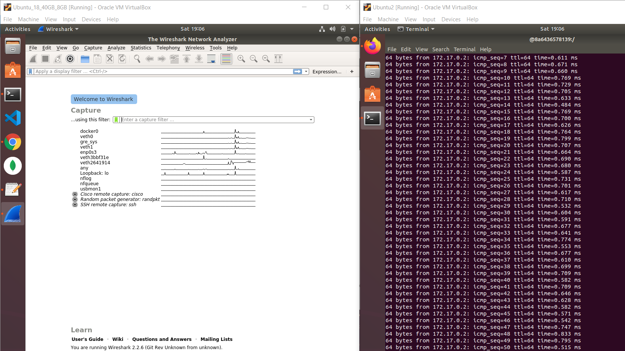
Wireshark
checked the traffic on Wireshark.

Slide 9
OpenDaylight
Installed the Dockerized OpenDaylight Carbon on one of the VMs
Install the features using feature:install

Slide 10
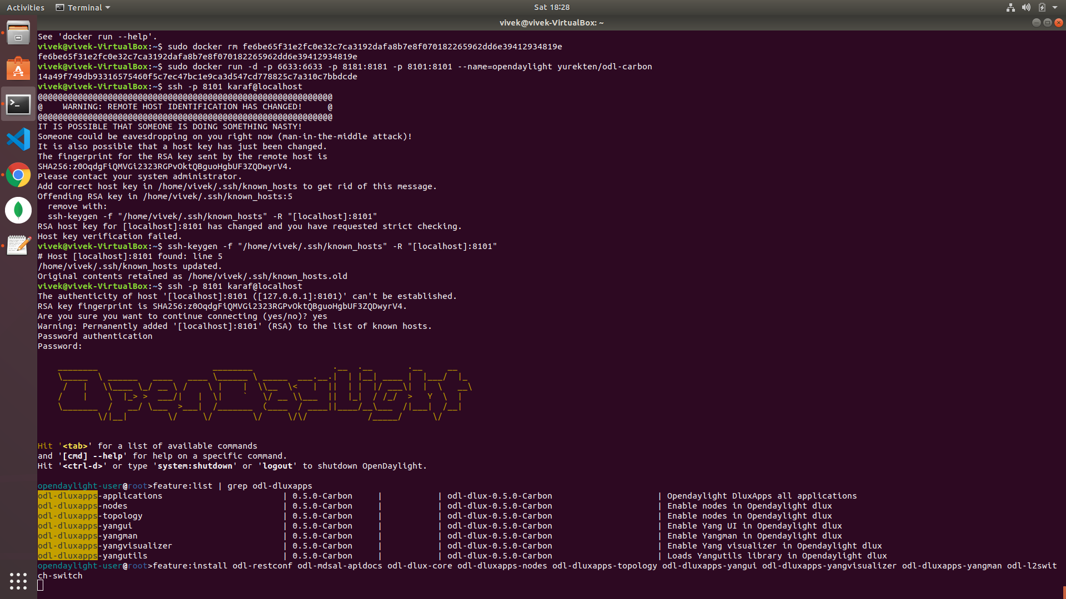

Slide 11
Challenges Faced
Main hurdle was learning Docker and containerization of applications.
Creating multiple heavy weight VMs on the same laptop machine.
Issues with JAVA versions
Issues with OpenDaylight versions
Issues with Docker container not stopping
Issue with SSH host key

Slide 12
Conclusion
Docker is a easy and efficient way to build and deploy any application.
We were successful in setting up a communication channel between 2 docker containers on different host machines using Open vSwitch.
We were able to use a containerized OpenDaylight-Carbon to display the topology of a Mininet running on a separate VM.

